Slide 1
Raspberry Pi Learning Setting up Raspbian
Mohammad Sabouri

Slide 2
Reference
https://learn.sparkfun.com/tutorials/setting-up-raspbian-and-doom
https://www.youtube.com/watch?v=y45hsd2AOpw

Slide 3
Introduction
The Raspberry Pi is a cross between a typical embedded system -- like an Arduino -- and a desktop computer. The Pi packs a 700MHz ARM11 Core with 512MB of RAM, HDMI and audio outputs, 2 USB ports, an Ethernet jack, and an SD socket with support for up to a 32GB SD card. In the eyes of some, it's one of the more powerful, cost-effective embedded boards to hit the market. To others, it's one of the most compact, bare-bones personal computers ever to grace the electronics world with it's presence. In either case, it's here to blur the line between the world of embedded electronics and personal computing.

Slide 4
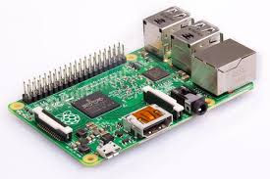
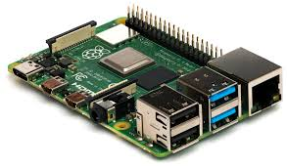
Raspberry Pi

Slide 5
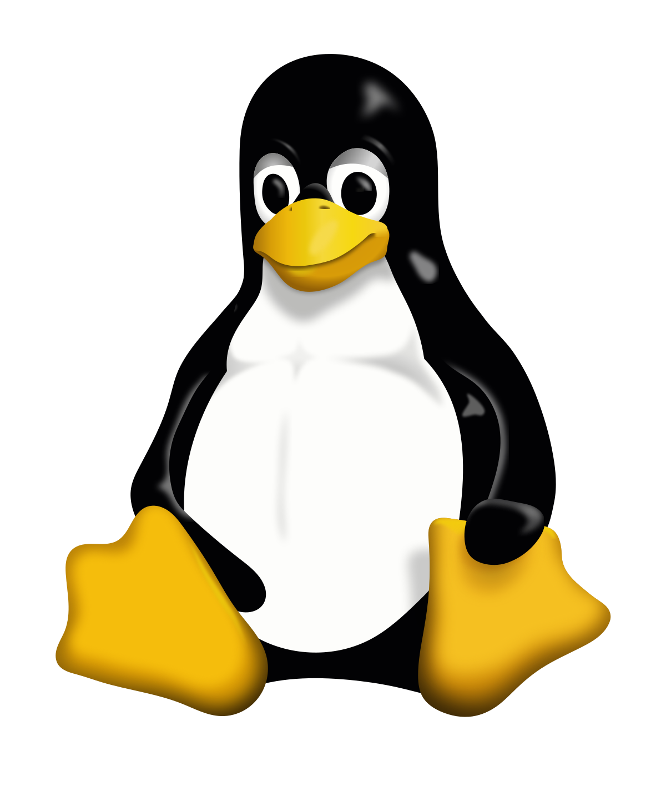
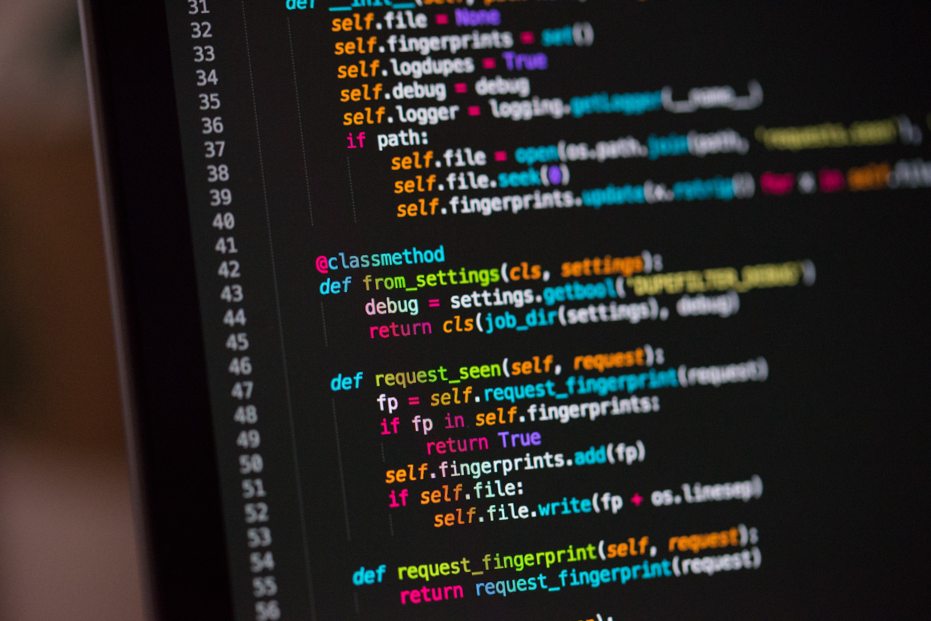
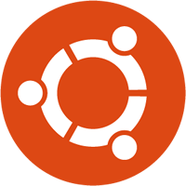
The Raspberry Pi is a great platform on which to learn Linux and programming

Slide 6
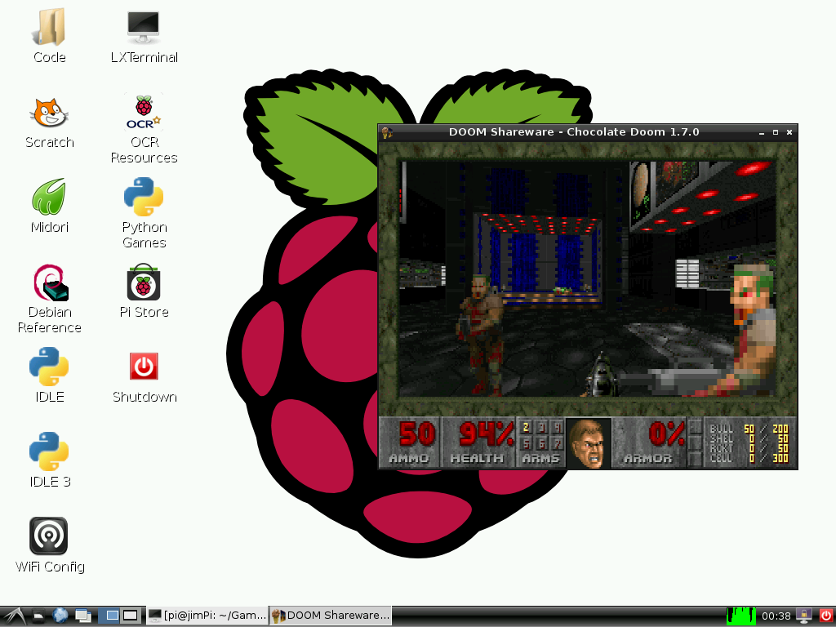
It's also a powerful solution for many "Internet-of-Things" projects out there, because it's so easy to get connected to the Internet. It can run Python scripts, or even compile programs written in C. It's a full-blown computer!

Slide 7
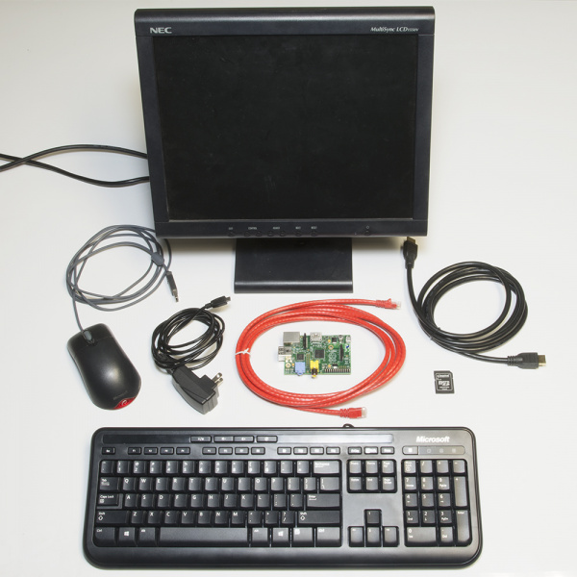
Required Materials

Slide 8
Required Materials
Raspberry Pi Model B or Model A (has less RAM and no Ethernet)
A 5V power supply with a micro USB termination. The supply should be able to source at least 700mA. Most phone chargers (with micro USB cables) should work.
An SD Card no smaller than 4GB, and no less than class 4.
A USB keyboard and mouse.
A display connected to either the HDMI or RCA composite video output.
If your monitor only has a VGA port, there are HDMI to VGA adapters to convert between the two. (You may need a beefier power supply if you're using that.)
If your monitor only has DVI, converting from HDMI is easy with an HDMI to DVI cable.
An ethernet cable and a connection to an Internet-connected network. (Optional, but very useful to get software updates [and Doom].)
Alternatively, you can use a USB WiFi module with the Pi. Check out our Wireless on the Pi tutorial for help setting that up.
Headphones or speakers with a 3.5mm stereo jack termination (optional, unless, for some reason, you don't want to hear the dying wails of former humans).

Slide 9
Prepare an SD Card
Before you can start installing Raspbian, you'll have to get the installer set up on an SD card. Follow the steps below to prepare your SD card by formatting it, and then installing the NOOBS software.
Windows
Mac OS X

Slide 10
SD Formatter for Windows

Slide 11
Format the Card
Download SDFormatter for Windows. Unzip it, and run Setup.exe. Follow along with the InstallShield Wizard to install SDFormatter.
Open SDFormatter.
Click Option and set FORMAT SIZE ADJUSTMENT to ON.
https://www.sdcard.org/downloads/formatter/eula_windows/

Slide 12
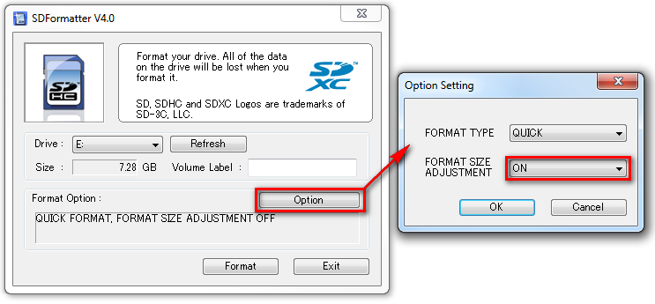
Open SD Formatter.
Click Option and set FORMAT SIZE ADJUSTMENT to ON.

Slide 13
Select your card from the Drive dropdown menu (if it wasn't selected automatically). Check and double-check that the drive letter is correct.
Click Format, then click OK a couple times. You should get a Drive Format complete! pop up shortly.

Slide 14
SD Formatter for Mac OS X

Slide 15
Format the Card
Download SDFormatter for Mac. Open the the downloaded file, and follow the Installer directions to install.
Open SDFormatter (it should be in your Applications folder).
Select Overwrite Format as the format option.
Select your card from the top dropdown menu (if it wasn't selected automatically). Make sure it's correct!
Click Format, and watch the progress bar slowly crawl across the bottom of the window. A Card Format complete ! message should appear once successful.

Slide 16
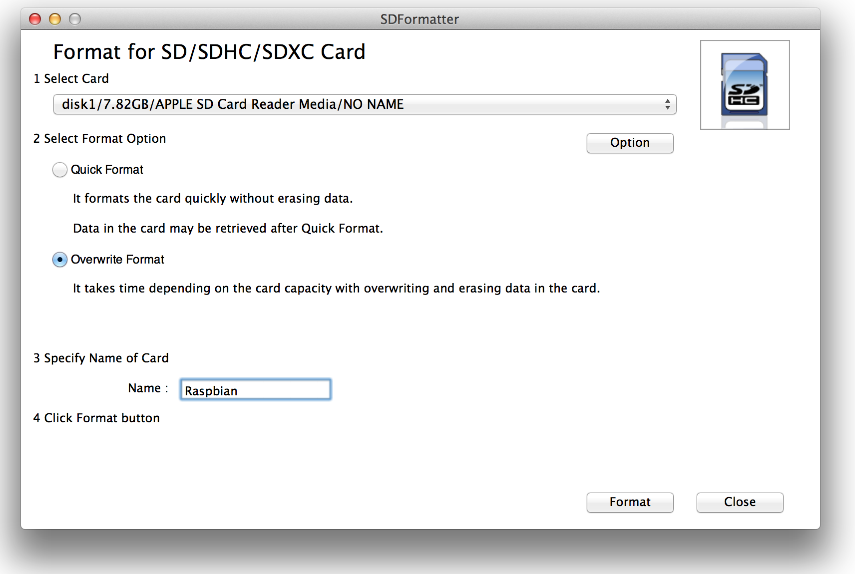

Slide 17
Download NOOBS

Slide 18
Raspberry Pi's New Out of Box Software (NOOBS) is recommended for first time Pi users (and even advanced ones). It includes a variety of useful operating system images (including Raspbian), and really simplifies the process
Head over to the Raspbery Pi downloads page, and download the most recent NOOBS (offline install) image (NOOBS_v1_3_2.zip as of writing this). It should be a 1-ish GB ZIP folder.
Once the download has finished, extract the ZIP folder and place the contents at the top level of your SD card. Once unzipped, the directory structure should look a little something like this

Slide 19
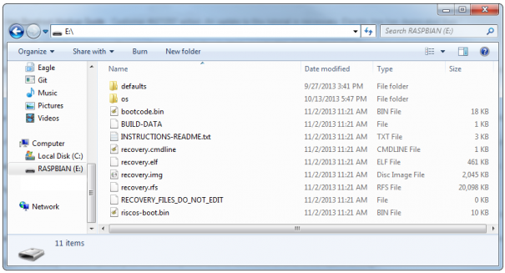

Slide 20
Prepare the Pi

Slide 21
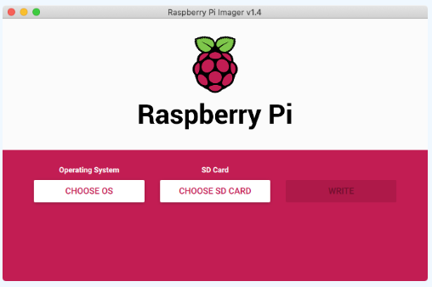
Install Raspberry Pi OS using Raspberry Pi Imager

